Slide 1
Turing College Data Analytics course Capstone Project Analysis of Superstore shop’s profits based on sales
Goda Beinortaite
2023-02-08

Slide 2
Objectives
Analyse historical sales and profit data from 2014 to 2018.
Identify what works best/worst in terms of sales and making profit.

Slide 3
Business questions
What is correlation between sales and profit?
What are the most and least profitable product categories?
What are the most and least profitable states?
How do the discounts contribute to the profit?

Slide 4
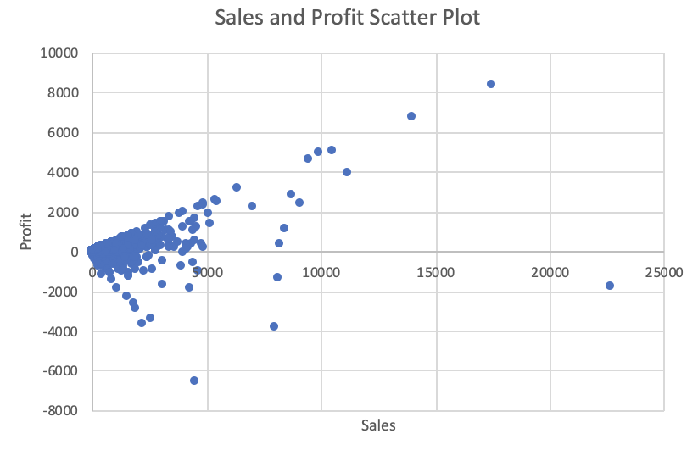
Profit and sales positive correlation
Plotted sales and profit in a scatter plot shows notable upward tendency.
However, TOP1 customer (Sean Miller) by most sales revenue is in negative profit.

Slide 5
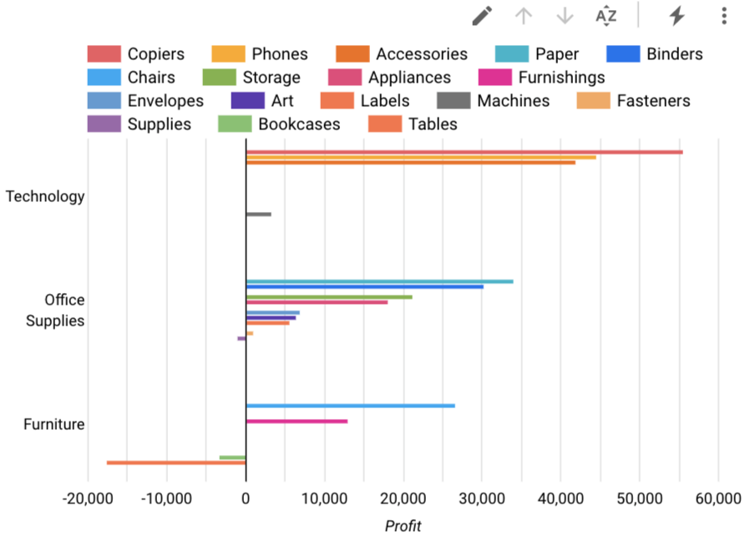
Categories and sub-categories by profit
The chart confirms that the profit on the sub-categories within Furniture are low. All of the sub-categories from Furniture are sold at a loss.
It seems Technology has a better track record of being profitable vs. the other categories.

Slide 6
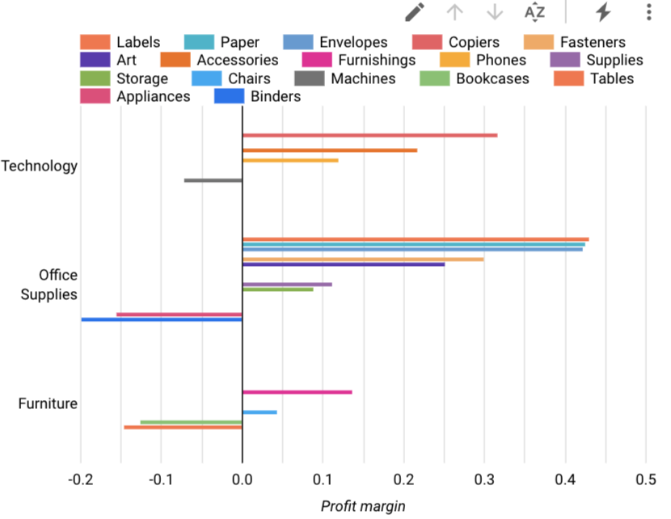
Categories and sub-categories by profit margin
Also, despite Office supplies being the most popular category by sales quantity, it demonstrates negative average profit margin for some sub-categories like Appliances and Binders.

Slide 7
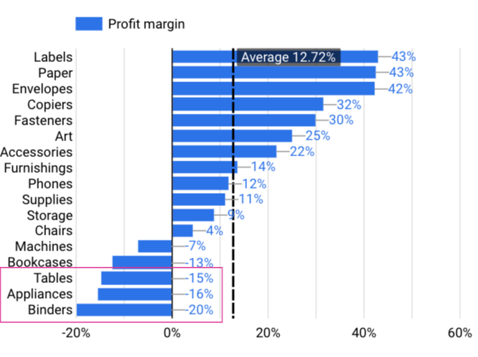
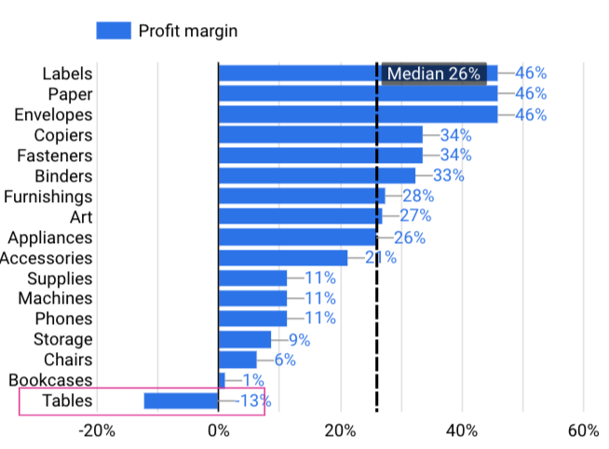
Average and median profit margin in sub-categories
Using the company's average total profit margin (12.72%) as a benchmark I compare these non-profitable sub-categories. From the 3 sub-categories that this Superstore is selling at a loss, Tables, Appliances and Binders are clearly categories where this store is struggling.

Slide 8
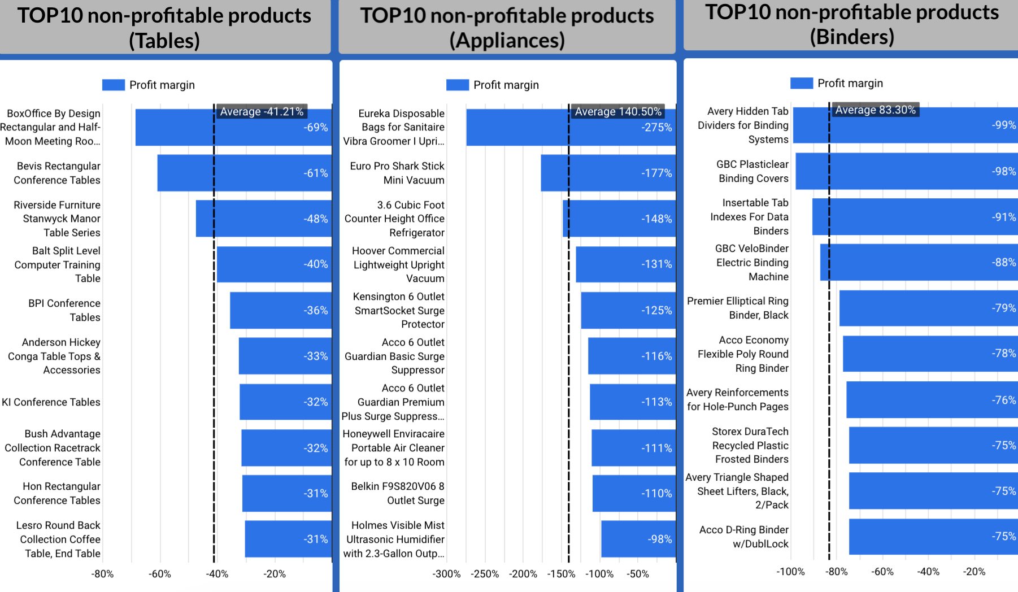
TOP10 worst items with lowest margins within each sub-category
Looks like the biggest negative margins are in Appliances section, with Eureka disposable bags being the worst.

Slide 9
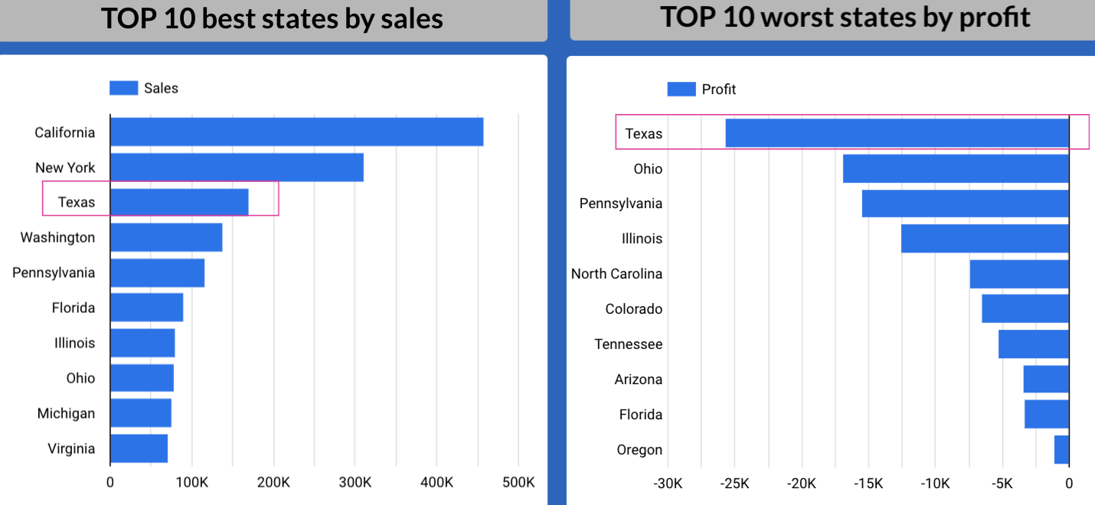
Texas demonstrates the lowest profit margins
California and New York states lead by sales and profit.
However, some of the states where this company is making most of their sales is actually bringing down the profit.
Texas, which is their 3rd highest segment of sales, contributes to more than 1/4 of the loss that the company is making on its sales.

Slide 10
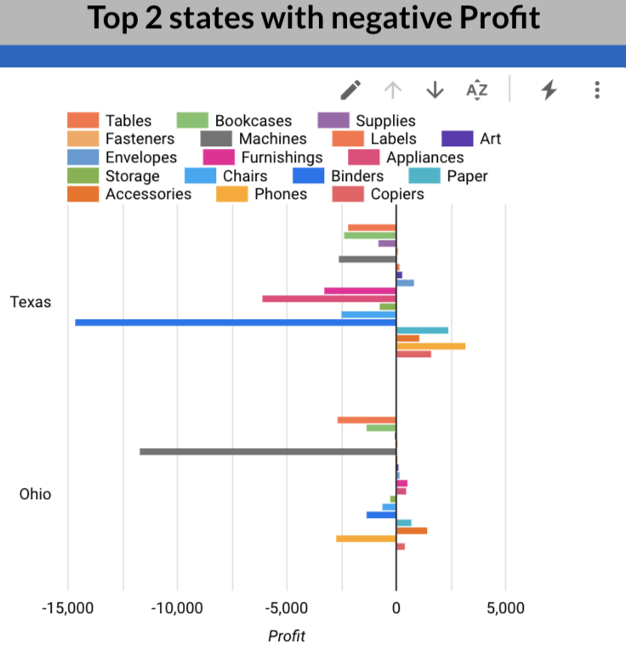
Negative profit sub-categories in non-profitable states
Majority of sub-categories have negative profit.
In Texas the top non-profitable sub-category is Binders and in Ohio it is Machines.

Slide 11
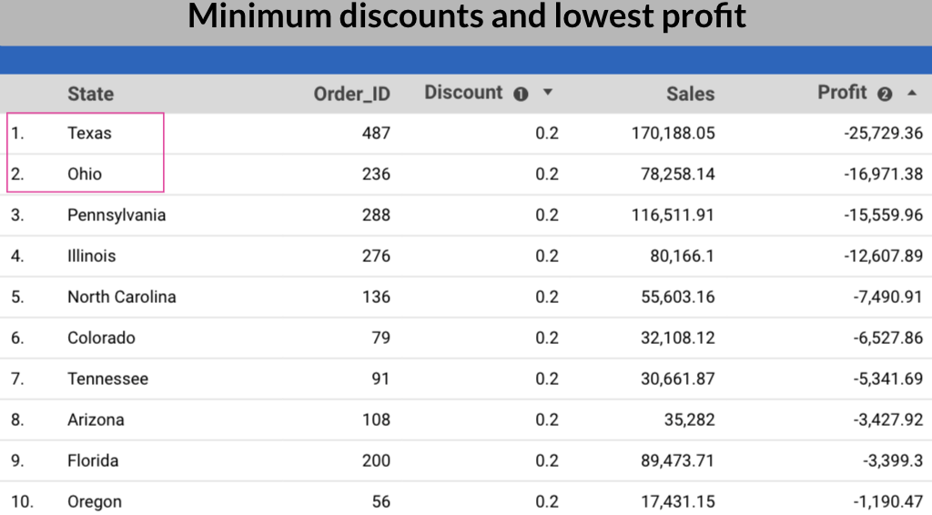
Discounts contribute to decreasing profit
There are some sub-categories with high number of orders with discount (for example binders, phones, chairs).
In some states like Texas or Ohio all orders are only with discounts which highly contributes to negative profit margin. Here minimum discount given is 20%.

Slide 12
Findings
Technology and Home Office have on average high profit margin, while Furniture are being sold at low margin or even at a loss for some its sub-categories.
The Consumer segment is driving most of the Superstore's sales and across all segments Technology is contributing the most to revenue.
Tables, Appliances and Binders are product categories being sold at a loss with lowest profit margin values.

Slide 13
Findings
Over 50% of profit is made in California and New York. Store is quite geographically dependent on keeping up their sales here.
Their sales in Texas (which is their 3rd highest state in sales) is on aggregate making a loss.
Some sub-categories, machines and tables, were the main drivers of loss in profits in states like Texas and Ohio. Almost all records of these products here netted negative profits.
Too many discounts are offered for some specific categories. In Texas and Ohio all products are sold with discount.

Slide 14
Recommendations
Target Consumer segment's customers when setting sales and marketing strategy.
Stop selling to states where most products on aggregate are making big loss (e.g. Texas, Ohio).
Stop selling non-profitable products or stop selling them only in the worst profit states (e.g. Eureka disposable bags).

Slide 15
Further analysis
Customer basket analysis
Identify items contributing to sales of other more profitable items.
Define and explore regular/non-regular customers.

Slide 16
Time for questions!

